Slide 1

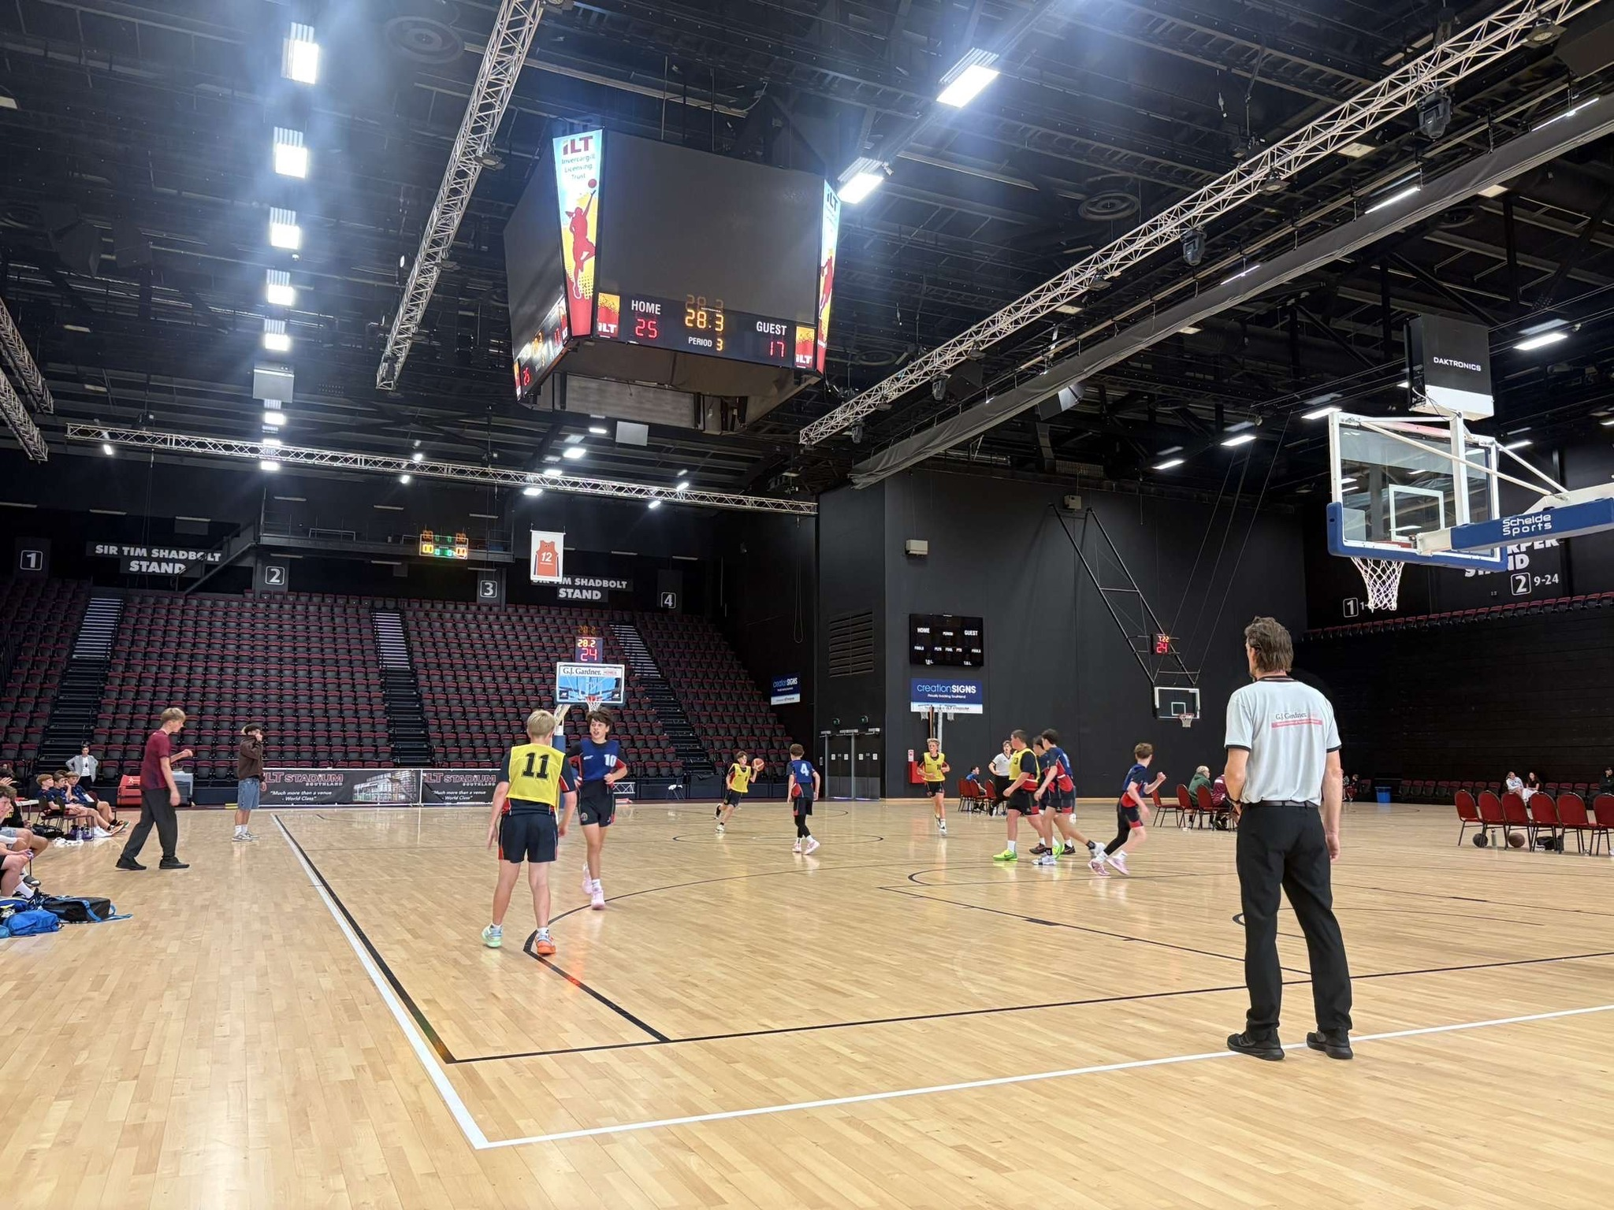
Junior High School Competition
2025

Slide 2
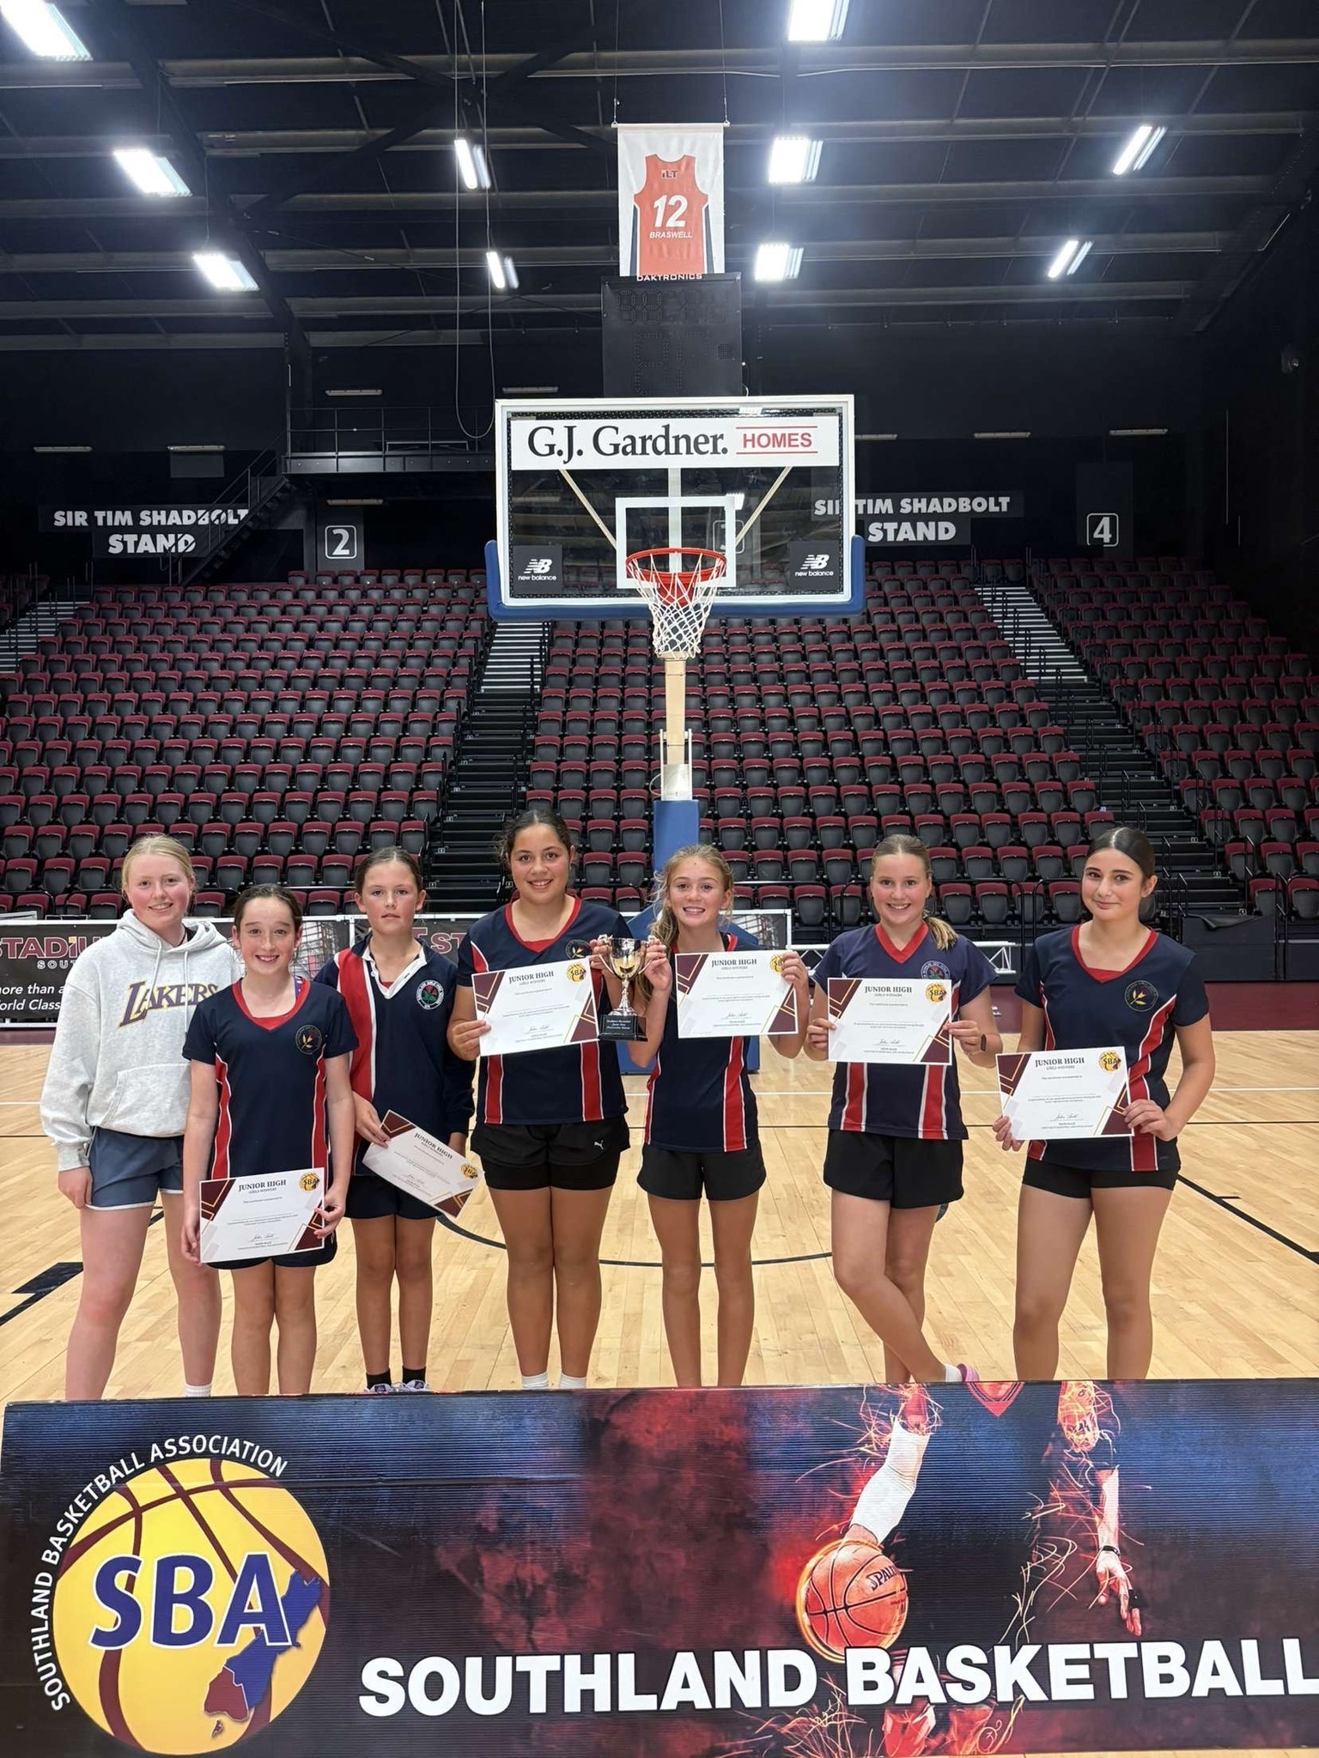
Grades
Boys Grade
Girls Grade
Dates Term 4
10th October – ILT Stadium
17th October – ILT Stadium
24th October – ILT Stadium
31st October– NO GAMES
7th November – ILT Stadium + Schools
14th November – ILT Stadium
21st November – ILT Stadium

Slide 3
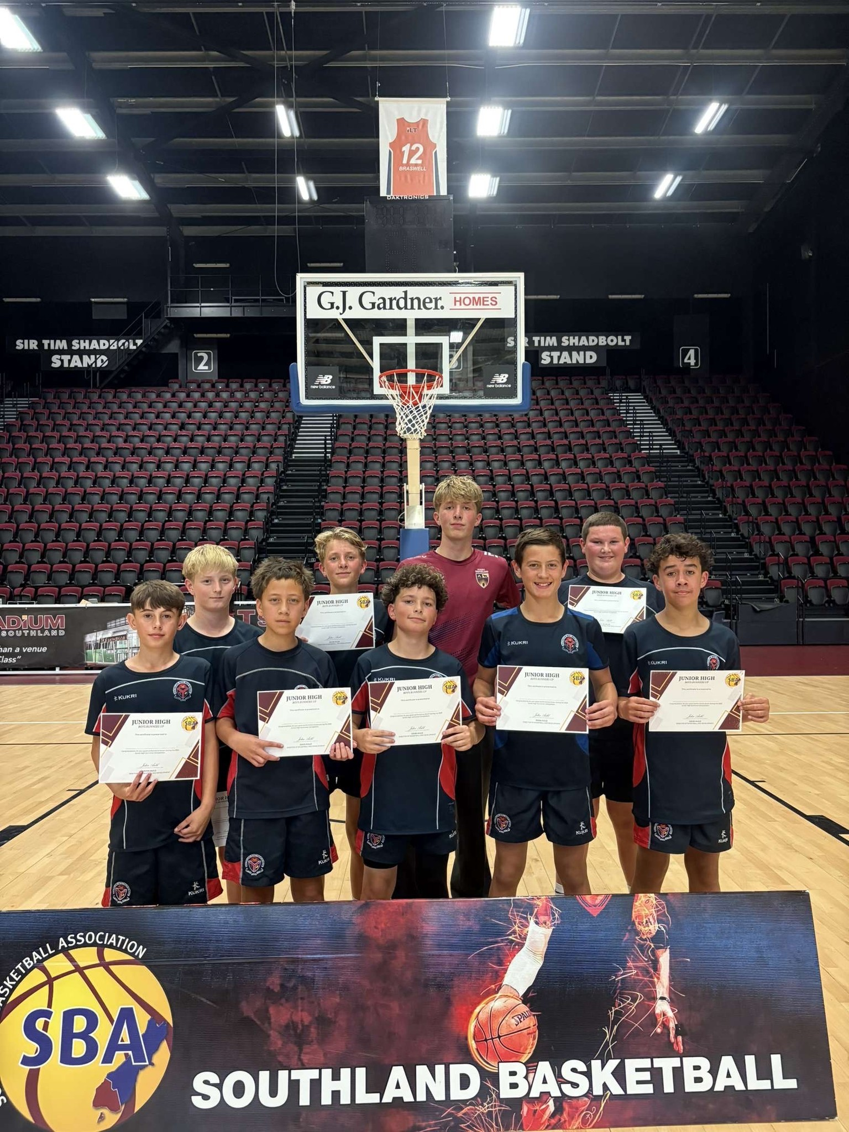
Costs
SBA Costs
$45.00 per player invoiced to school
BBNZ Levy
U14 $5.00
15-19 $10.00
20+ $15.00
SBA will have an open session tonight after this meeting, and available to help with any issues that come up prior or during the competition.

Slide 4
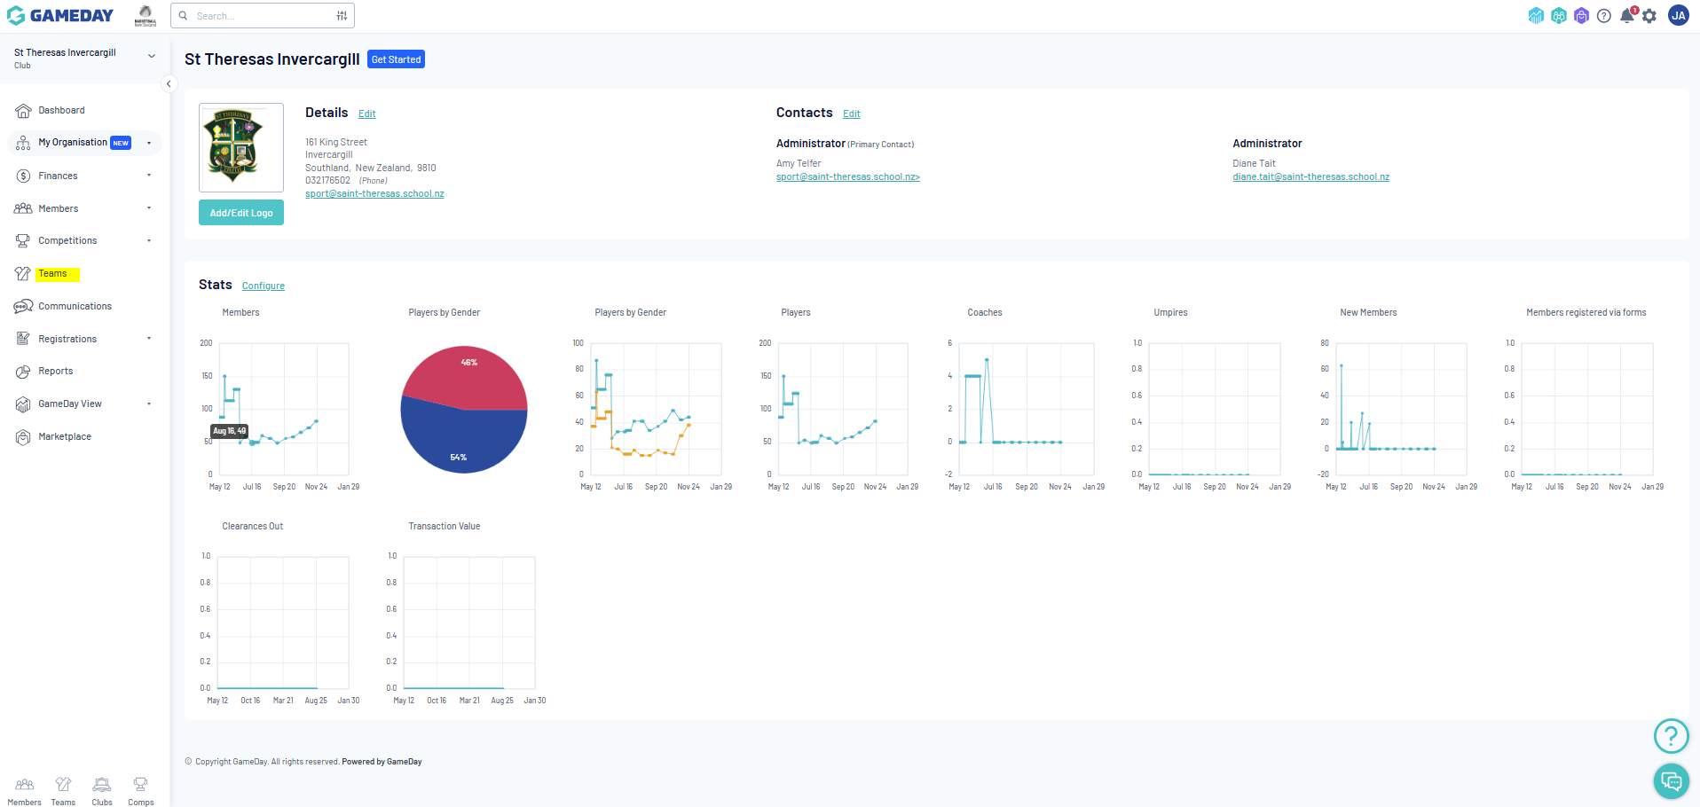
GAMEDAY (Team Code - 1)

Slide 5
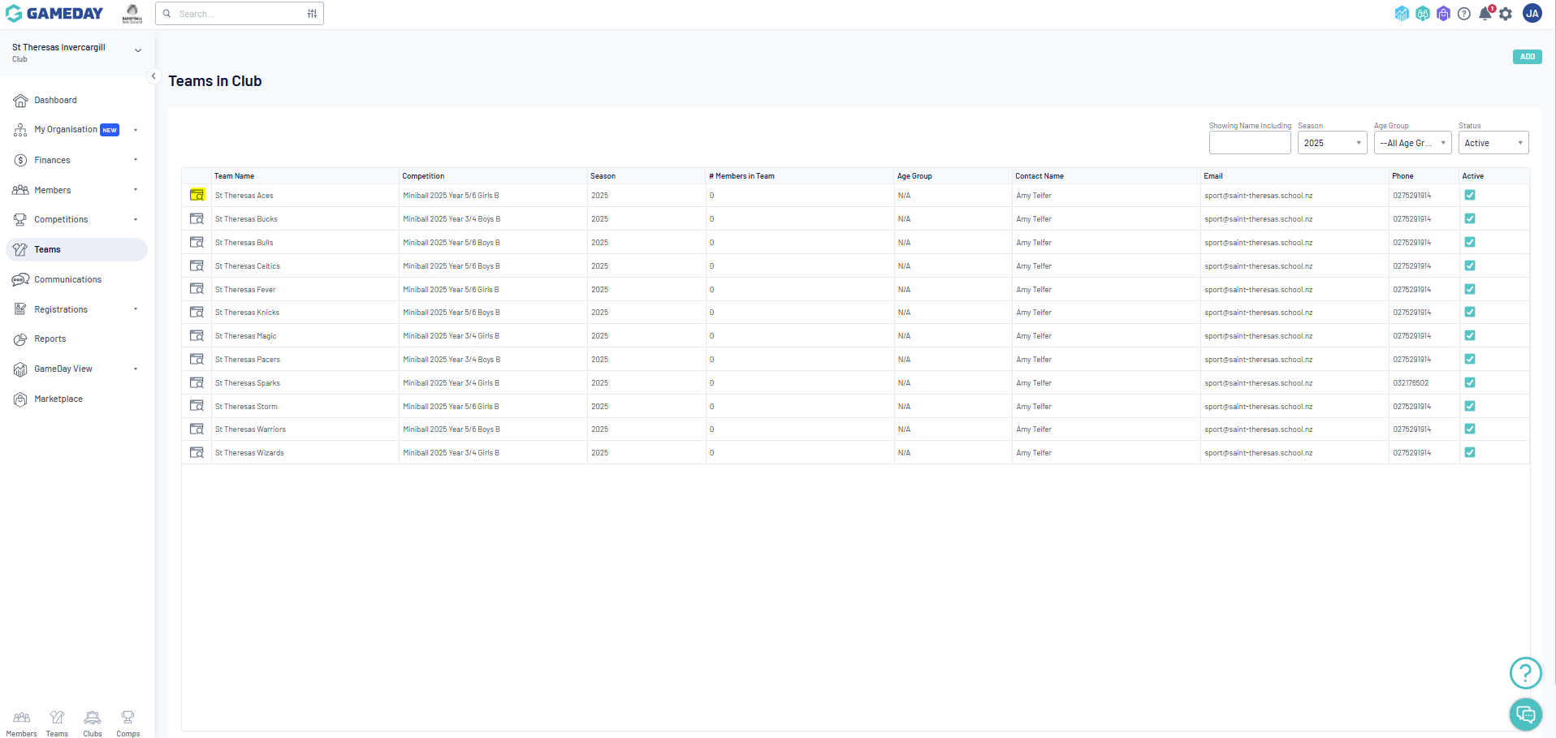
GAMEDAY (Team Code - 2)

Slide 6
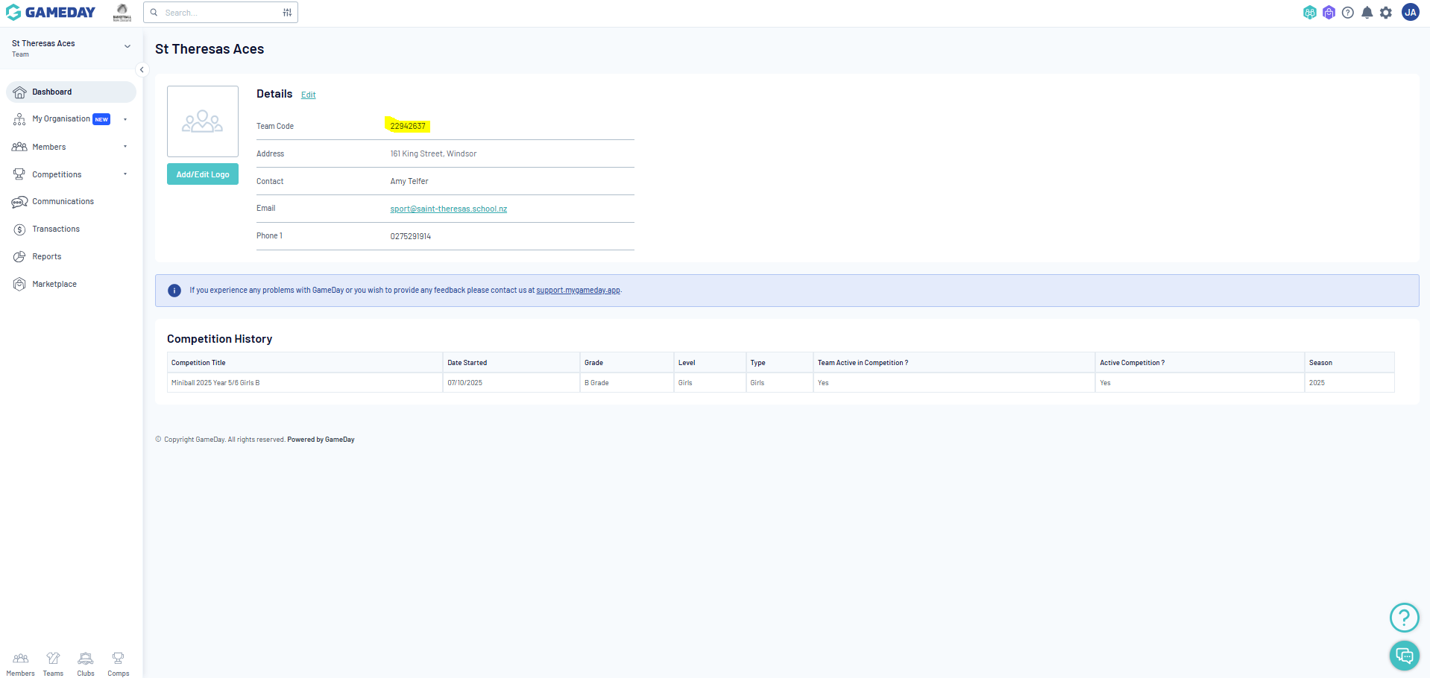
GAMEDAY (Team Code - 3)

Slide 7
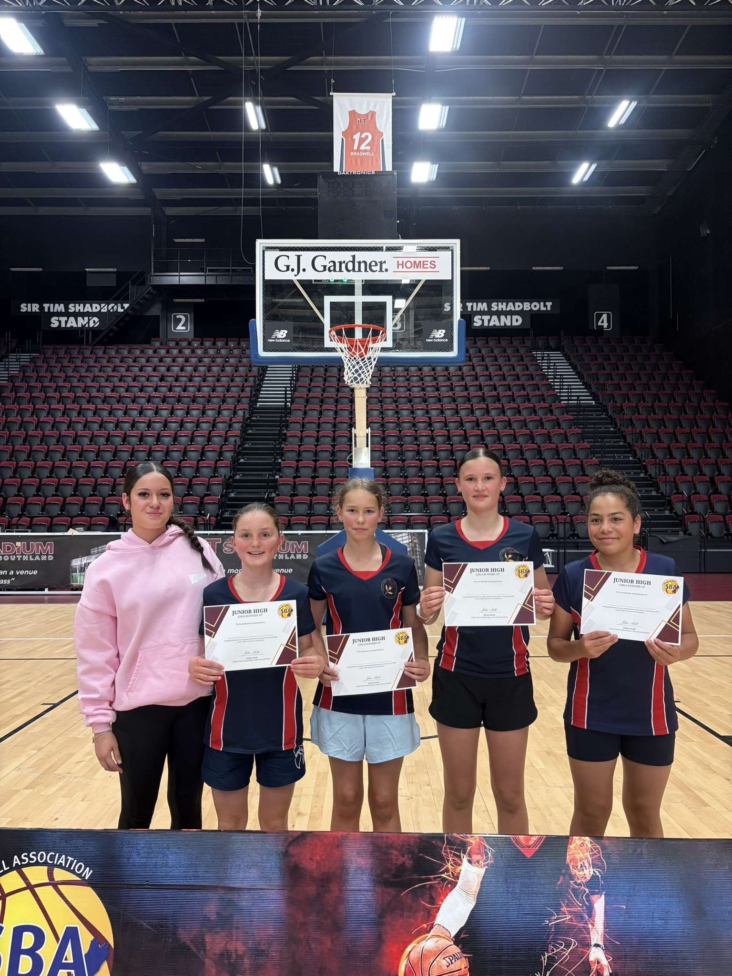
All Grades
4x8 min running clock quarters stop clock in last 2 mins if game is within 6 points
Mouth guards must be worn by all players
No jewelry to be worn while playing
Once up by 15+ points, teams must retreat to opposite 3pt line after a basket.
Failure to implement these rules will result in an investigation which could result in loss of points on results table
Rules for each grade

Slide 8
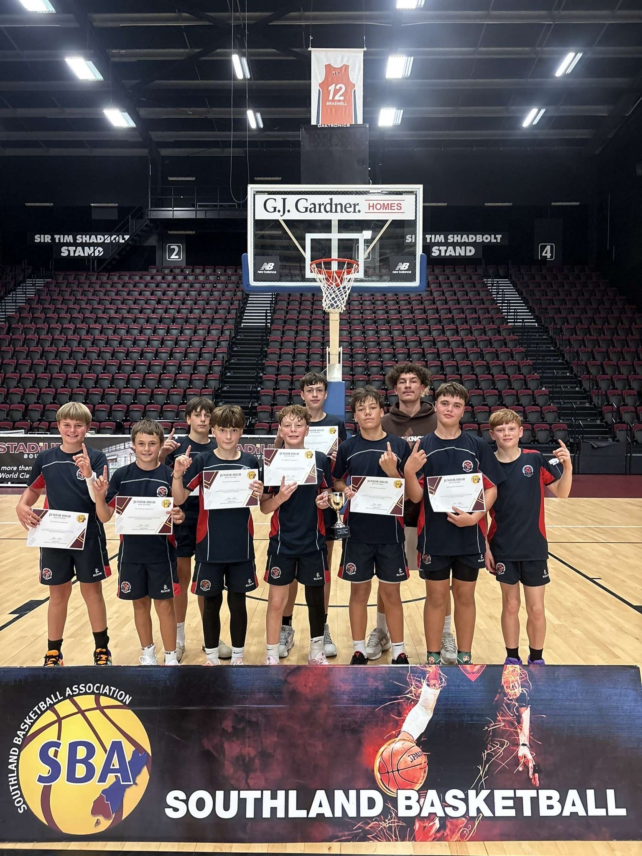
- A Grade Boys Champions
- A Grade Girls Champions if applicable
- SBA Miniball Service Award
- SBA Miniball Referee Potential Award
There will also be player of the day awards available
Awards

