Slide 1

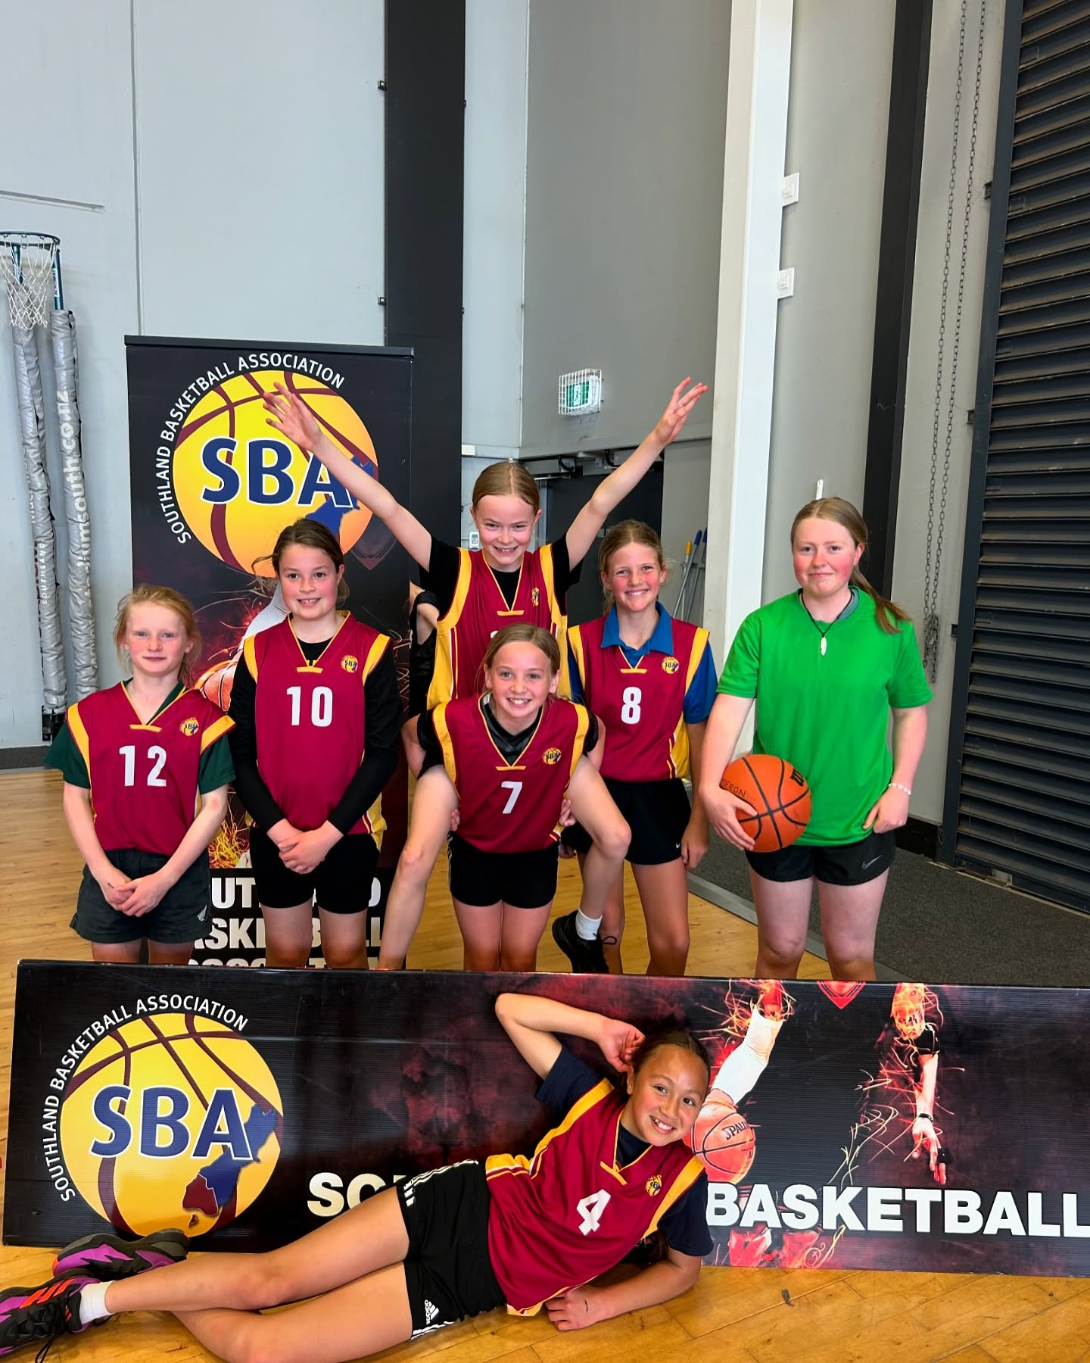

GJ Gardner Miniball School Competition
2025

Slide 2
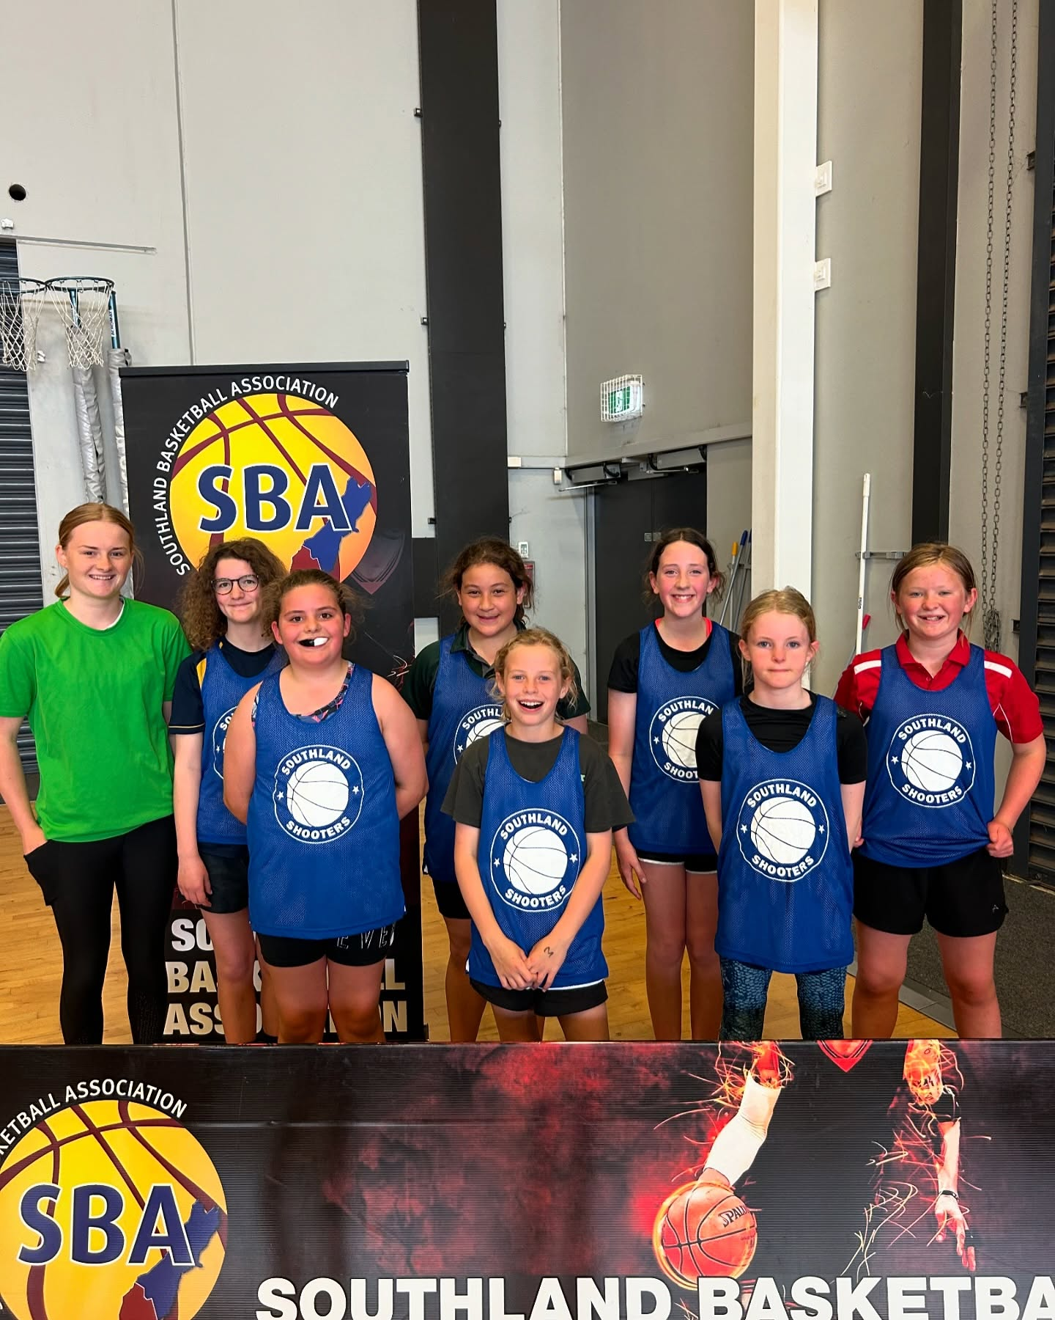
Grades
Year 3-4 Boys A (2 teams)
Year 3-4 Boys B (15 teams)
Year 3-4 Girls A (2 teams)
Year 3-4 Girls B (10 teams)
Year 3-4 Mixed (10 teams)
Year 5-6 Boys A (7 teams)
Year 5-6 Boys B (17 teams)
Year 5-6 Girls A (4 teams)
Year 5-6 Girls B (12 teams)
Year 5-6 Mixed (4 teams)

Slide 3
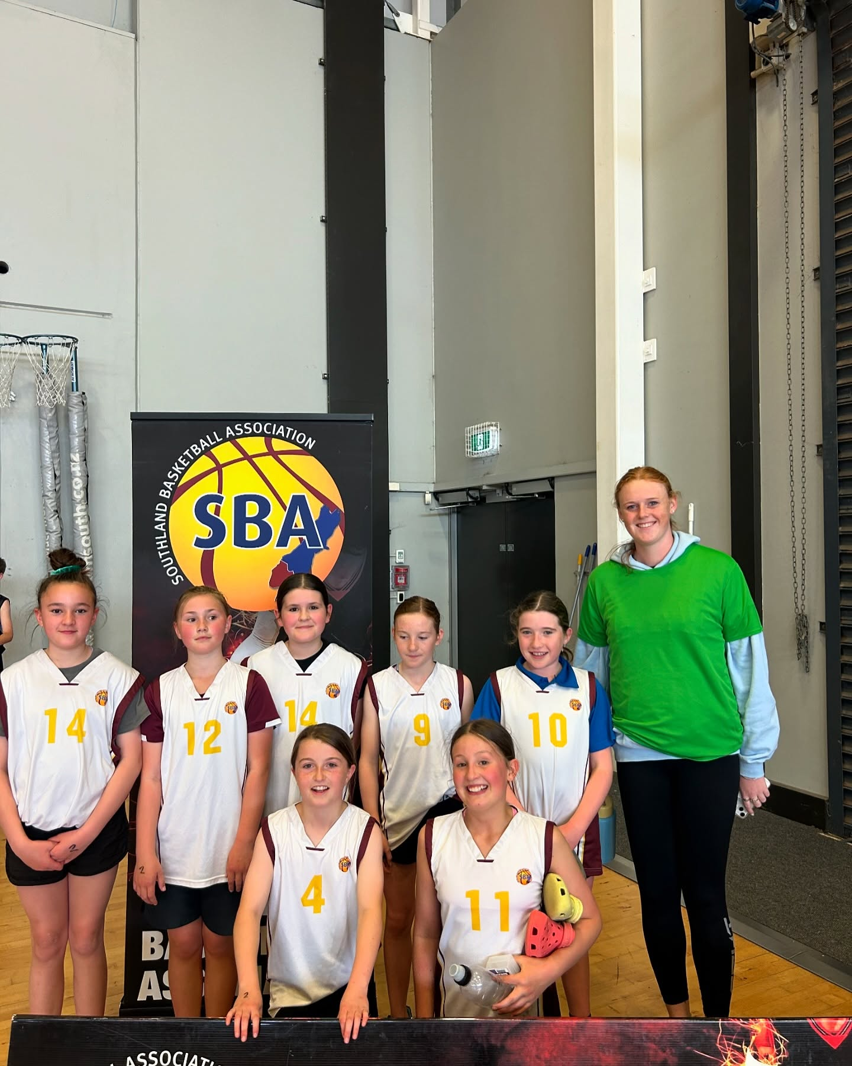
Dates Term 4
7th October – ILT Stadium
14th October – ILT Stadium
21st October – ILT Stadium
28th October– ILT Stadium
4th November – ILT Stadium + Schools
11th November – ILT Stadium
18th November – No Games
25th November – ILT Stadium
2nd December – ILT Stadium
28th November – 5-6 end of year competition day

Slide 4
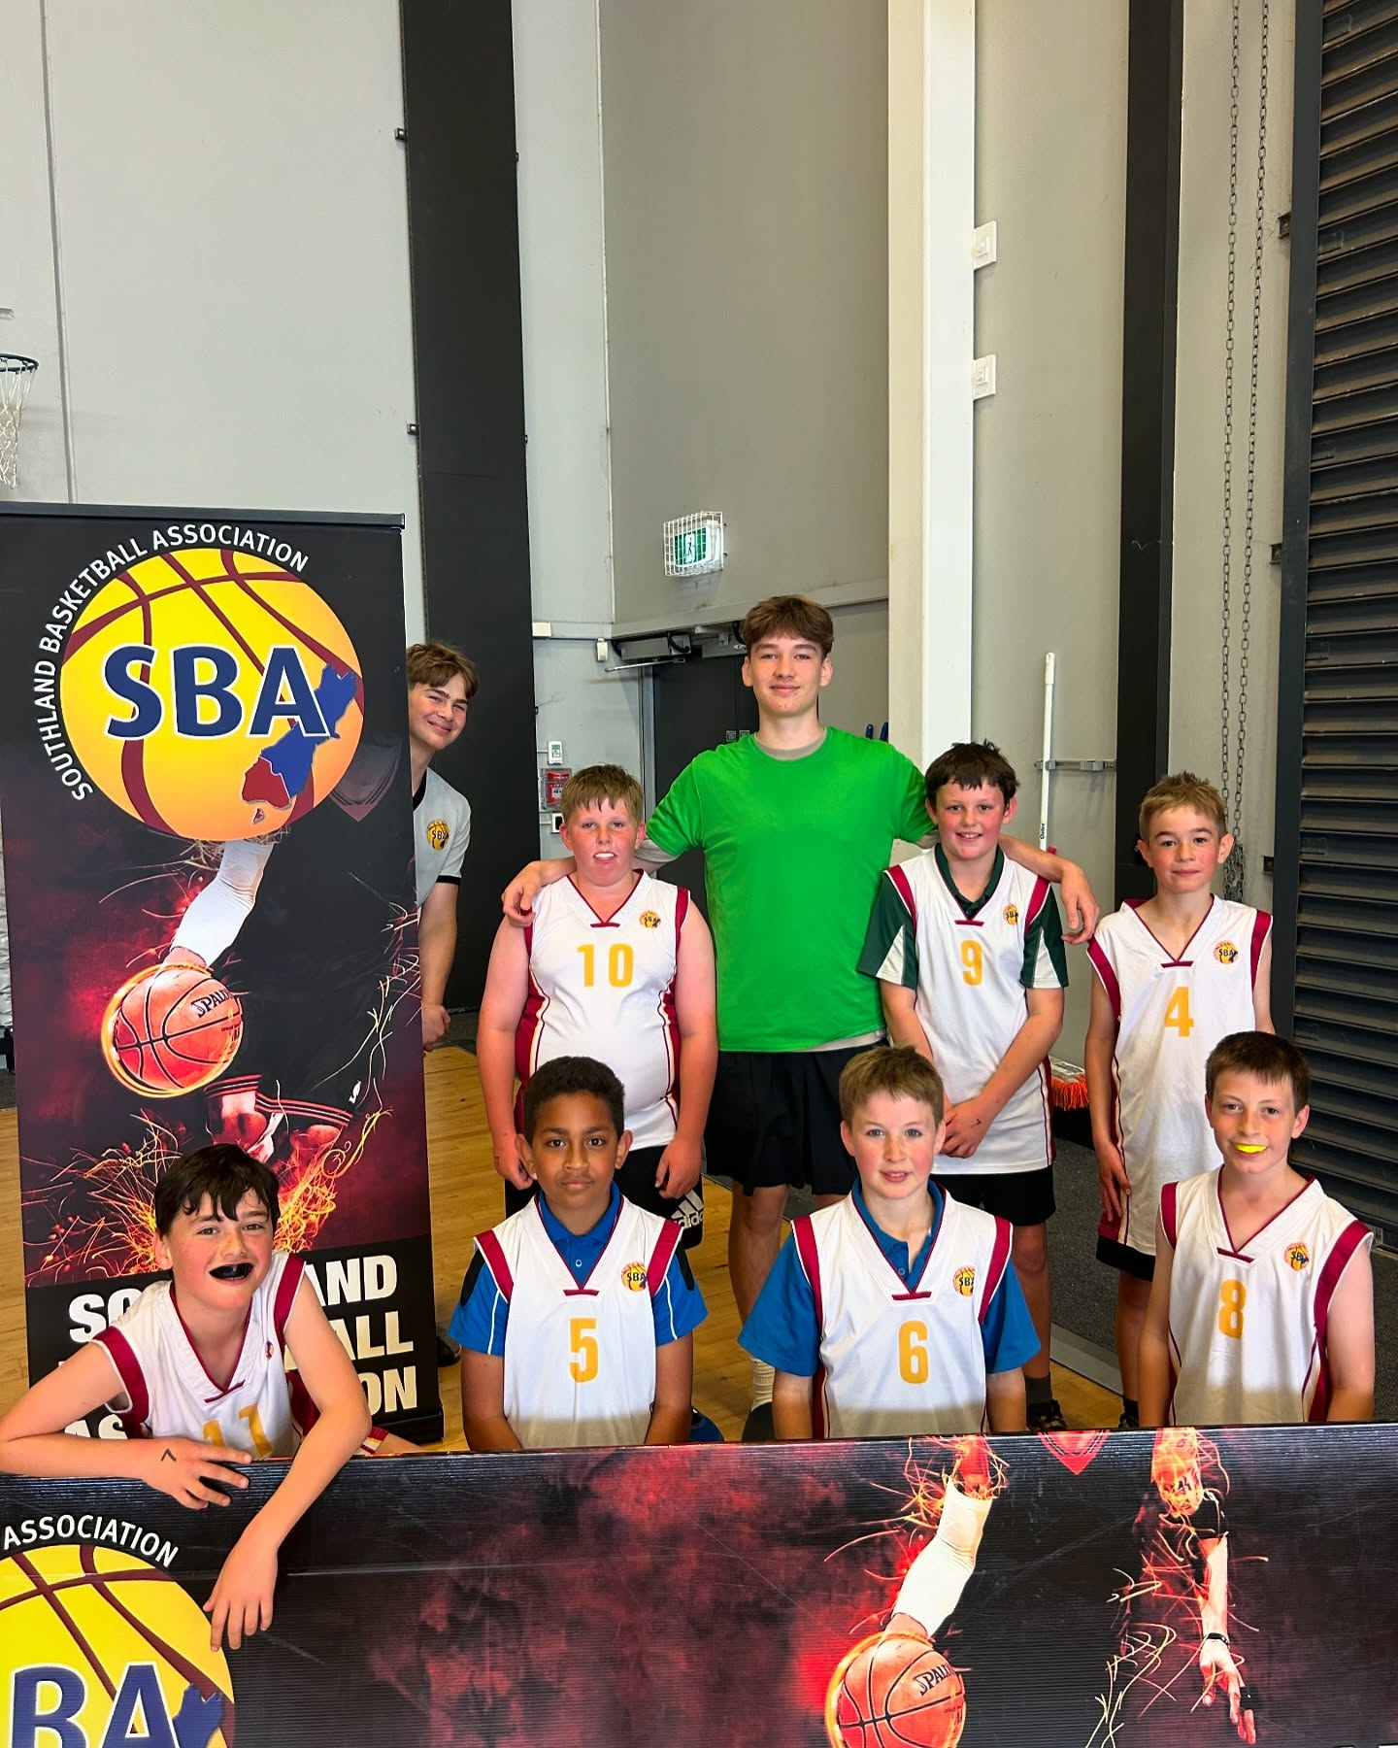
Costs
SBA Costs
$45.00 per player invoiced to school
BBNZ Levy
U14 $5.00
15-19 $10.00
20+ $15.00
SBA will have an open session tonight after this meeting, and available to help with any issues that come up prior or during the competition.

Slide 5
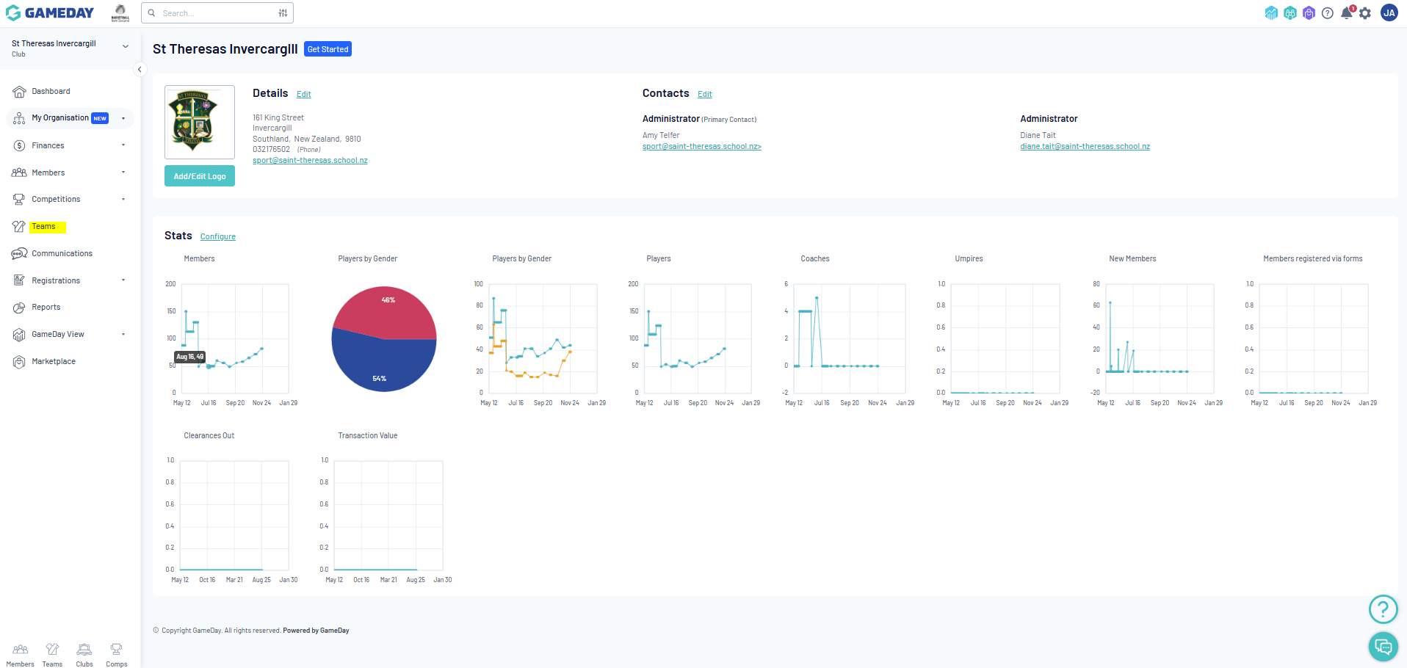
GAMEDAY (Team Code - 1)

Slide 6
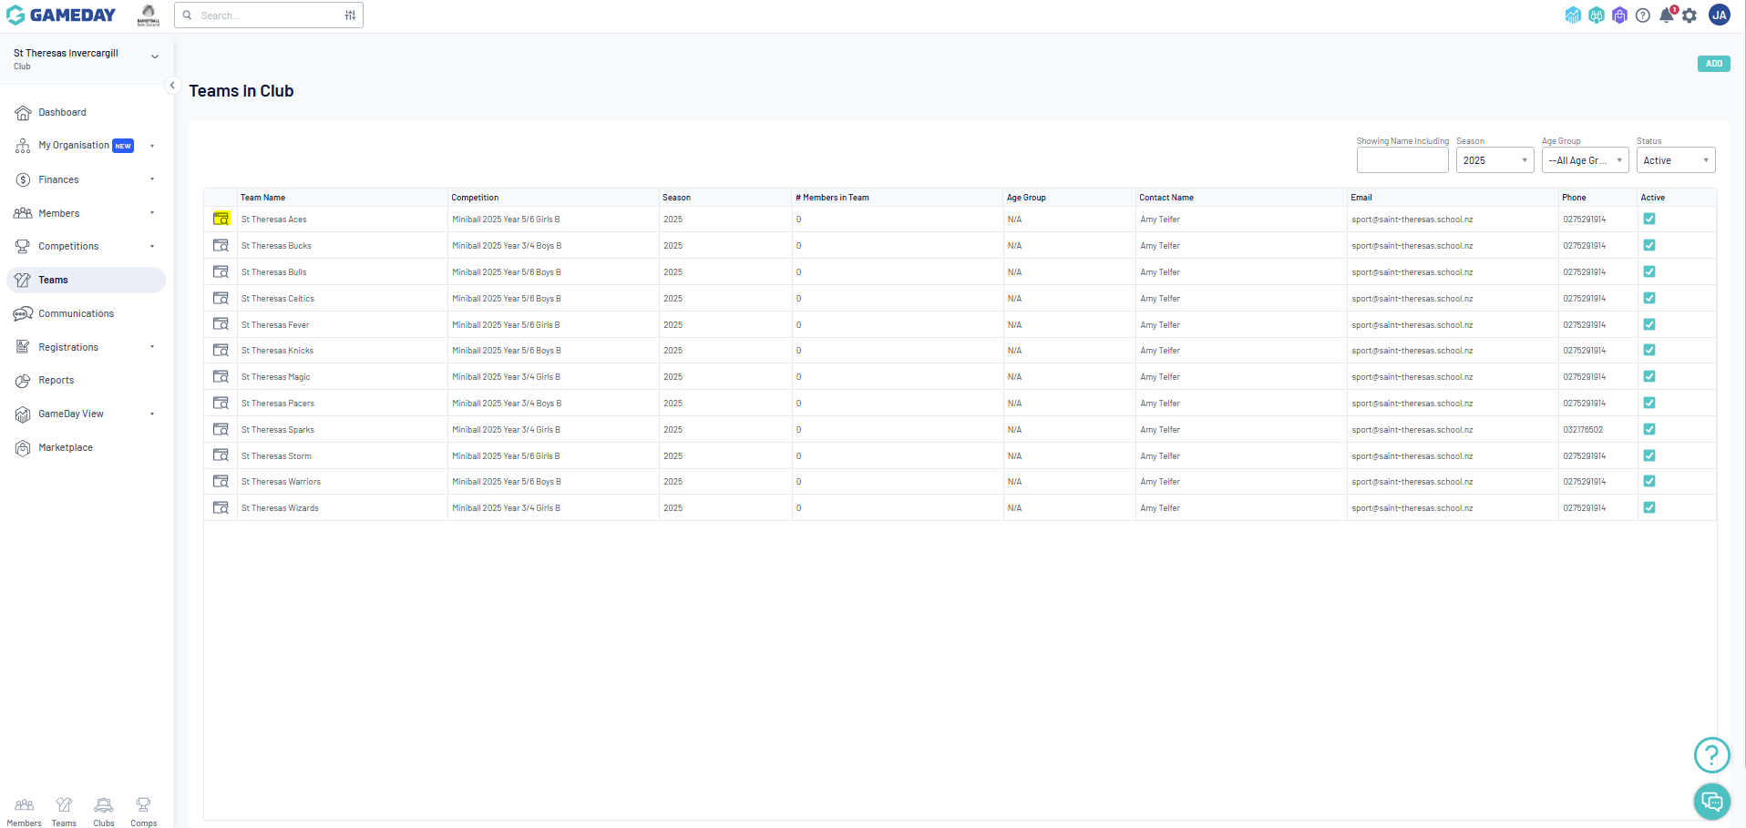
GAMEDAY (Team Code - 2)

Slide 7
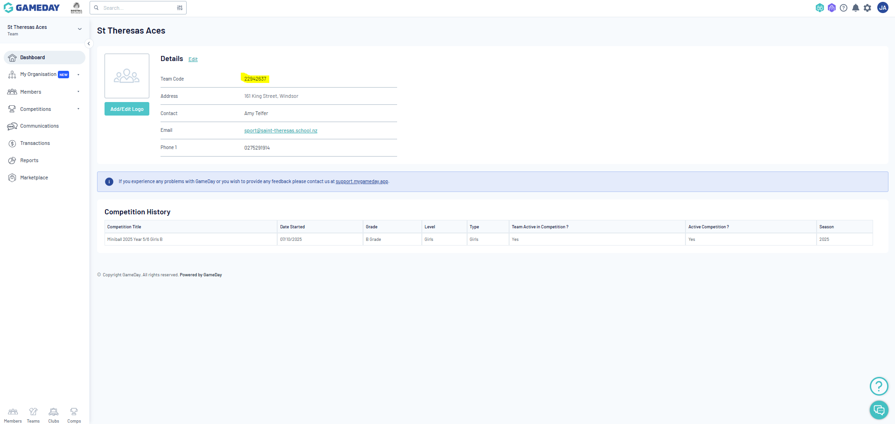
GAMEDAY (Team Code - 3)

Slide 8
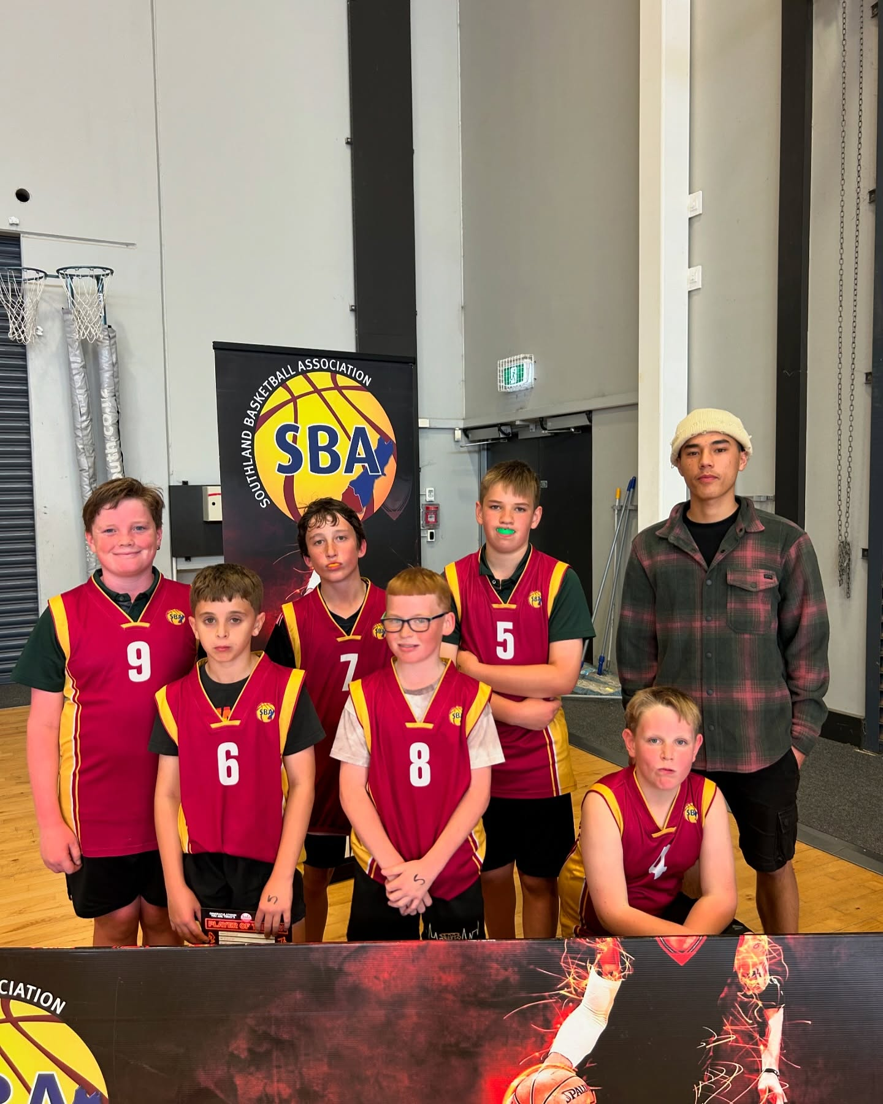
All Grades
2x12 min running clock Half
No stop clock or time outs
Mouth guards must be worn by all players
No jewelry to be worn while playing
Years 3-4
No Full court, teams must retreat to half way after each basket
Years 5-6
Once up by 10+ points, teams must retreat to half way after a basket.
Failure to implement these rules will result in an investigation which could result in loss of points on results table
Rules for each grade

Slide 9
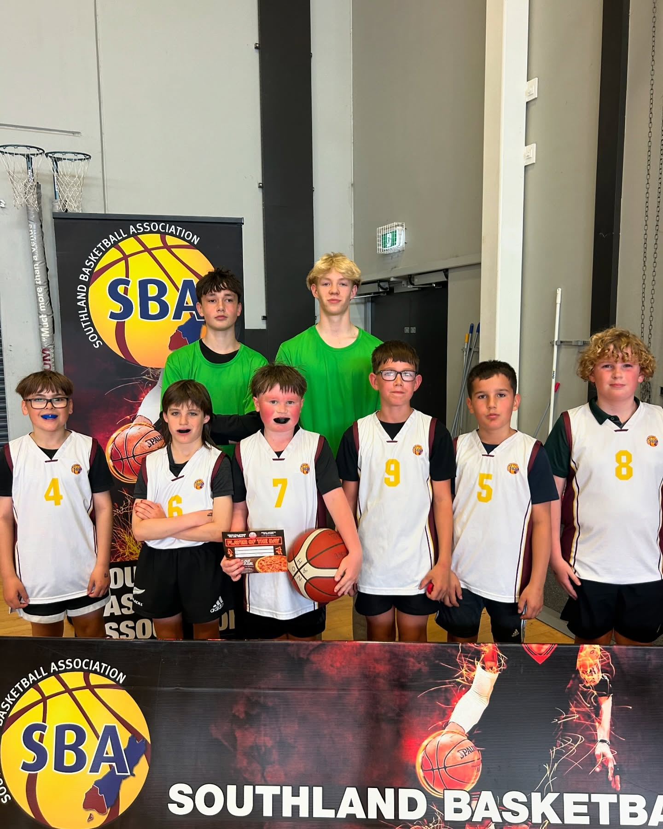
- Year 3-4 A Grade Boys Champions if applicable ( 2 teams)
- Year 3-4 A Grade Girls Champions if applicable (2 teams)
- Year 5-6 A Grade Boys Champions
- Year 5-6 A Grade Girls Champions
- SBA Miniball Service Award
- SBA Miniball Referee Potential Award
Awards

